Slide 1


Slide 2


Slide 3


Acute Fatty Liver of pregnancy (AFLP)
By
A. Lect. Mostafa Elateek

Slide 4

When the pregnancy turns into a hepatic emergency
The race against maternal and fetal deterioration

Slide 5
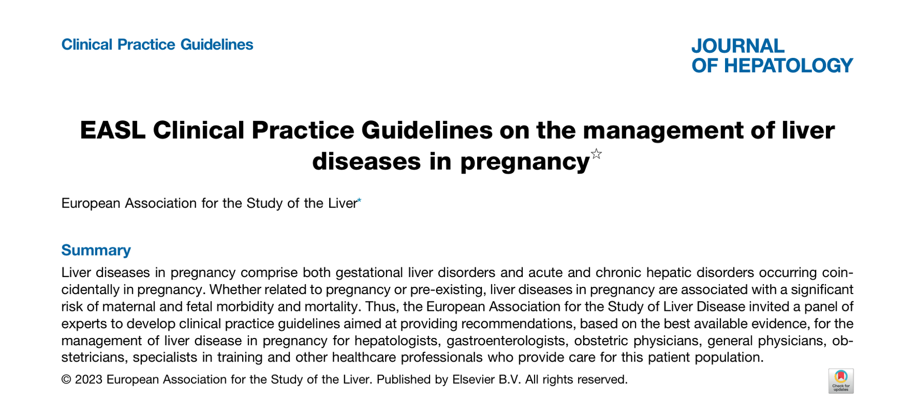
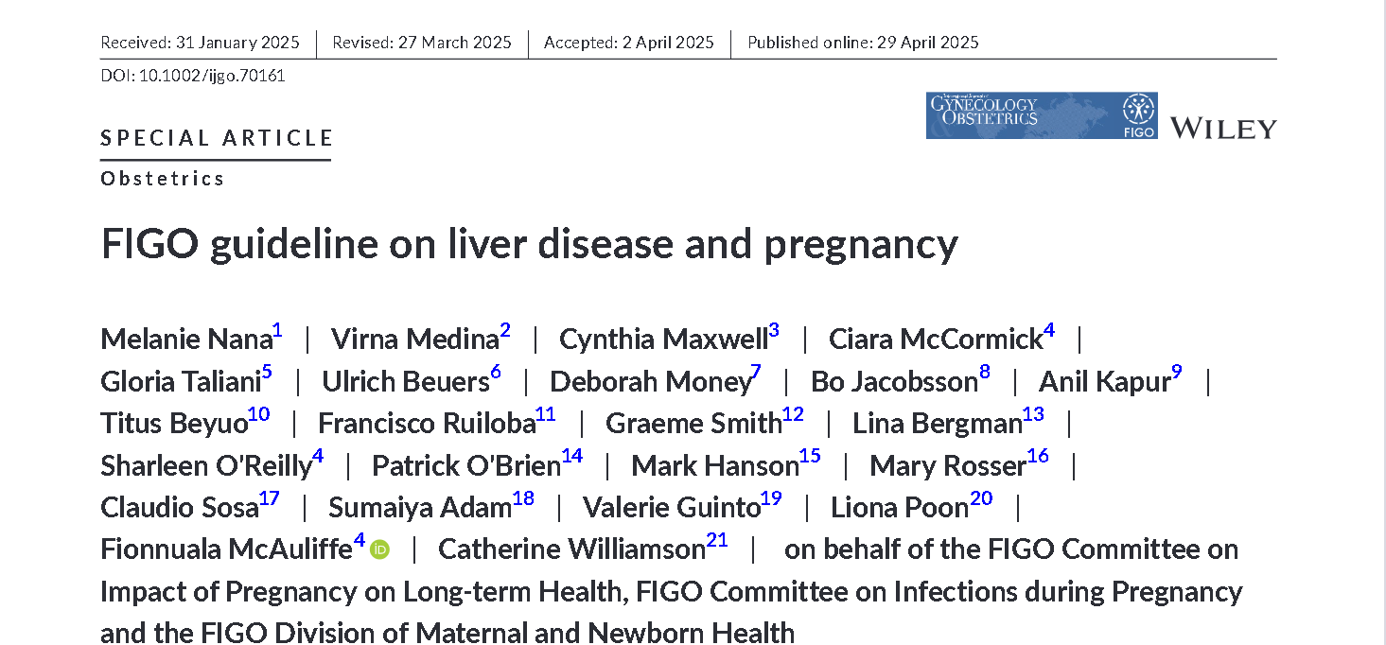
The data involved in this presentation are based on the EASL 2023 and FIGO 2025 guidelines.
“The extracted data were reconstructed and presented in a question-and-answer format.”

Slide 6
Why is AFLP an obstetric–medical emergency??
1. It can progress rapidly to acute liver failure
Hypoglycemia → impaired hepatic gluconeogenesis
Lactic/metabolic acidosis
Hyperbilirubinemia
Coagulopathy in 52%
Encephalopathy in 18%
Acute kidney injury in approximately 80%
Acute liver failure in 47.3% and multiorgan failure 2%
Simply, microvesicular fatty accumulation in hepatocytes with mitochondrial dysfunction, impairing hepatic metabolic and synthetic function Consequently, AFLP produce

Slide 7
2. The fetus is also at immediate risk
Maternal metabolic and hepatic failure can lead to:
fetal/infant death rates of approximately 7–11%
Fetal distress around 46%
preterm delivery around 48%
Placental dysfunction/metabolic disturbance → fetal distress → fetal hypoxia → stillbirth
Waiting for spontaneous resolution of pregnancy is inappropriate once AFLP is diagnosed ,so trigger delivery and stabilization, regardless of gestational age.

Slide 8
Why it can be missed ??
Why does it occur mainly late in pregnancy?
typically presents in the third trimester
Late pregnancy has:
Increasing maternal metabolic demand
Increased fatty-acid utilization
Greater fetal metabolic activity
Greater placental/fetal contribution to fatty-acid metabolism
Occurs in approximately: 1 in 10,000–20,000 births
So, approximately 0.005–0.01% of pregnancies are affected.
Only susceptible pregnancies may reach the metabolic threshold at which hepatic injury develops.

Slide 9
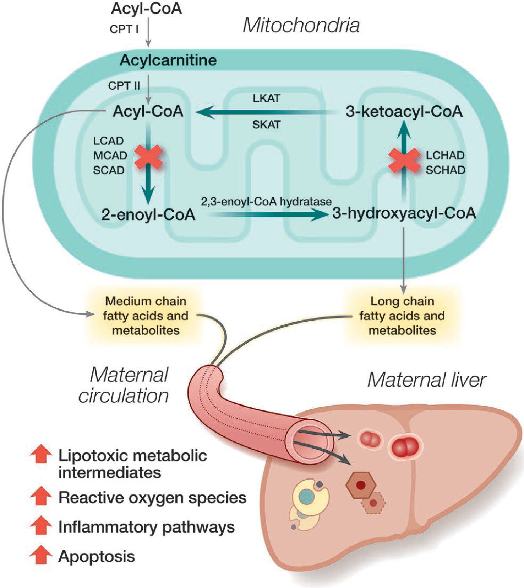
What about the pathophysiology ??
Naoum EE, et al. Acute fatty liver of pregnancy: pathophysiology, anesthetic implications, and obstetrical management. Anesthesiology. 2019;130:446–461.

Slide 10
Pathophysiology
Deficiency of (LCHAD) = long-chain 3-hydroxyacyl-CoA dehydrogenase
MICROVESICULAR STEATOSIS = Multiple tiny lipid droplets within hepatocytes, rather than one large fat vacuole.
The important point is that this is primarily a mitochondrial/metabolic injury, rather than simply "fat deposition in the liver.“ This differs from typical macrovesicular steatosis seen in MASLD.
“LCHAD and other fatty-acid oxidation defects are implicated in a subset of cases; the overall pathogenesis remains incompletely understood.”

Slide 11
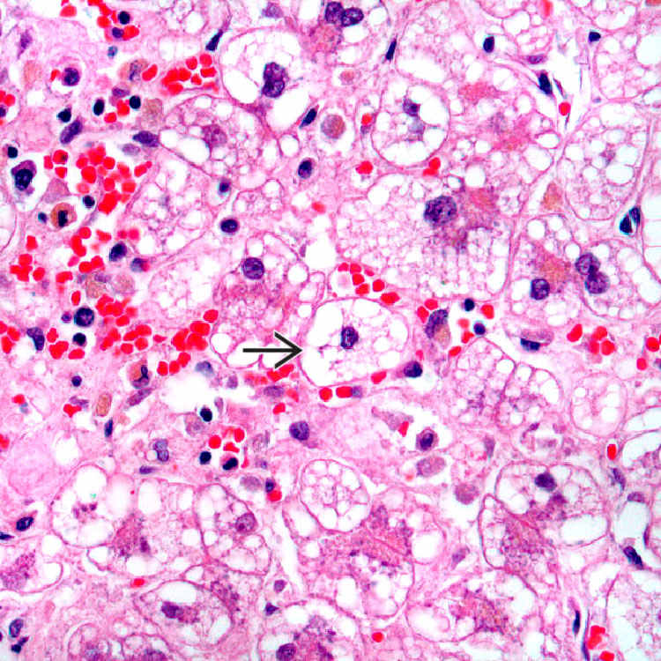
MICROVESICULAR STEATOSIS in (AFLP)

Slide 12

Can we raise suspicion with some risk factors??
Extremes of maternal age
Low maternal BMI
Pregnancy-induced hypertension
Multifetal pregnancy
Fetal growth restriction (FGR)
Male fetus

Slide 13
How to diagnose AFLP ??
The main validated clinical tool is the Swansea criteria
≥6 criteria + exclusion of another diagnosis→ diagnosis of AFLP
Liver biopsy is NOT required because
The diagnosis can usually be made clinically.
The patient may have severe coagulopathy.
Performing an invasive procedure in an unstable pregnant woman is undesirable.
AFLP has no single diagnostic test.
Diagnosis is clinical + biochemical, supported by imaging, and after excluding alternative diagnoses.

Slide 14
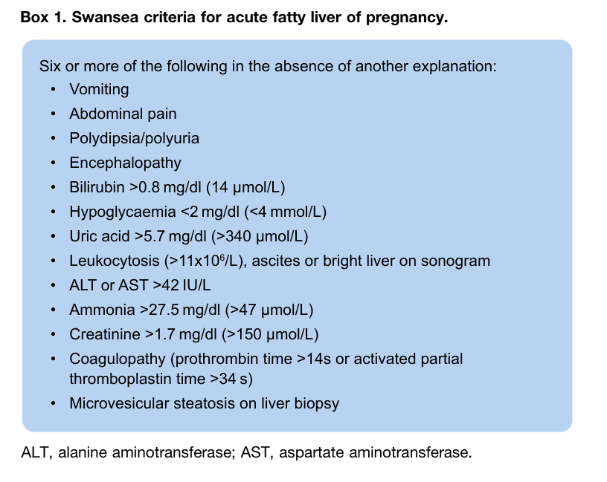

Slide 15
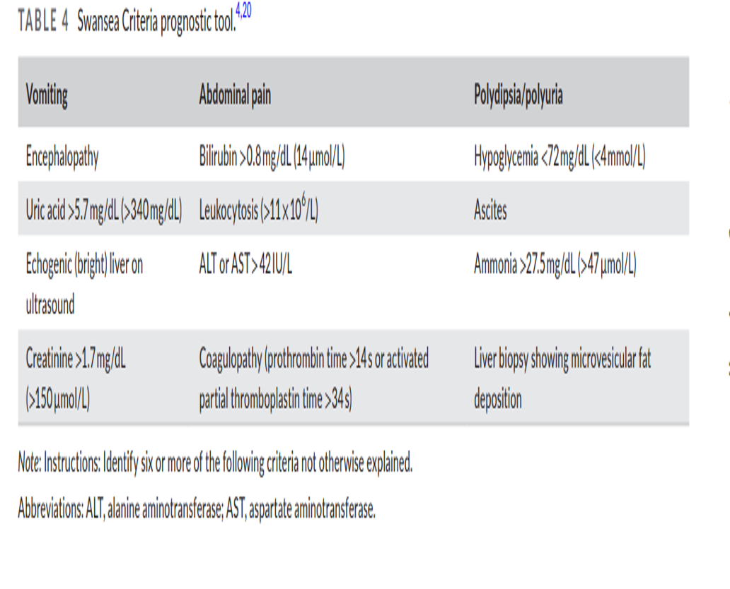

Slide 16
What is the management strategy ??
Immediate admission + Multidisciplinary management
Admit to hospital urgently, preferably a center with:
Maternal–fetal medicine/obstetrics
Hepatology
Anesthesia/critical care
Neonatology
Liver-transplant access if severe

Slide 17
& Assess repeatedly
Vital signs and urine output
Mental status/encephalopathy
Glucose level
CBC/platelets
PT/INR, aPTT, fibrinogen
AST/ALT, bilirubin, ALP/GGT
Creatinine/urea
Electrolytes
Blood gas/lactate
Ammonia
Blood cultures if infection suspected
LDH ± uric acid

Slide 18
2. Decide whether ICU/Level 2–3 care is required
EASL specifically identifies the following as markers for higher-level/ICU care:
Encephalopathy
Lactate >2.8 mg/dL
MELD ≥30
>7 Swansea criteria

Slide 19
3. Correct the metabolic abnormalities before delivery
A. Hypoglycemia:
Frequent glucose monitoring
Continuous dextrose infusion may be required
Avoid prolonged fasting
B. Coagulopathy: Assess
INR/PT
aPTT
Fibrinogen
Platelets
Clinical bleeding

Slide 20
To facilitate safe delivery and invasive procedures using appropriate blood products according to the coagulation profile and local protocol:
FFP
Cryoprecipitate/fibrinogen replacement
Platelets
Packed RBCs when indicated
The aim is not simply to normalize the INR, but to achieve adequate hemostasis for delivery/procedures

Slide 21
4. Fluid/electrolyte and renal management:
Careful IV fluid management
Correct electrolyte abnormalities
Strict fluid balance
Urine output monitoring
Avoid nephrotoxic drugs
Treat AKI according to standard critical-care principles

Slide 22
5. EXPEDITED DELIVERY (definitive treatment)
Complete normalization of ALT/AST
Normal bilirubin
Resolution of jaundice
Normal INR if this can be corrected sufficiently for delivery
Spontaneous labor
Fetal maturity when maternal deterioration is occurring
Delivery is the only definitive treatment for AFLP.
Do NOT wait for:

Slide 23
Route of delivery:
Vaginal delivery can be considered when:
Mother is stable after correction
Fetus is stable
Vaginal delivery is expected to be reasonably rapid
There is no obstetric contraindication
Caesarean delivery may be preferred when:
Maternal deterioration is rapid
Fetal distress
Obstetric indication
Vaginal delivery is unlikely to be sufficiently rapid
Severe AFLP makes urgent delivery necessary
The route should be individualized by the Obstetric + Hepatology + Anesthesia MDT.

Slide 24
Management after delivery:
Plasma exchange (NOT routine):
plasma exchange may be considered after delivery
It may improve disease severity and shorten recovery time but limited evidence
N-acetylcysteine (NAC):
NAC can be considered in women with AFLP requiring ICU admission (weak recommendation).
Delivery does not mean the patient immediately becomes normal.
Approximately 5–25% of cases present postpartum
So, patients require close monitoring post partum.

Slide 25
6. Acute liver failure / transplantation:
If severe hepatic impairment persists or the patient develops features suggesting irreversible acute liver failure:
Do not wait until irreversible multiorgan failure is established before contacting the transplant center.
Early referral to liver transplantation

Slide 26
7. Neonatal assessement:
The neonate should therefore receive appropriate neonatal assessment and consideration of testing for fatty-acid oxidation disorders
8. After recovery:
Confirm resolution of:
Liver enzymes
Bilirubin
INR/coagulopathy
Renal dysfunction
Hypoglycemia
9. Future pregnancy:
Recurrence is relatively uncommon overall generally <10%., but future pregnancies should be regarded as high risk, particularly when there is a known fatty-acid oxidation disorder.

Slide 27
DD key words
HELLP syndrome: (Hemolysis + ↑AST/ALT + ↓Platelets) hypertension/proteinuria common; LDH ↑, schistocytes, RUQ/epigastric pain
Preeclampsia: (Hypertension + proteinuria/end-organ dysfunction) headache, visual symptoms, renal dysfunction; ↑AST/ALT; platelets may fall
Acute viral hepatitis: Very high AST/ALT, often >1000 IU/L, jaundice; exposure/prodroma +ve; no hemolysis or thrombocytopenia pattern, viral markers positive.
Intrahepatic cholestasis of pregnancy (ICP):Pruritus without rash, especially palms/soles, ↑bile acids, jaundice usually mild, no major synthetic failure.
Hyperemesis gravidarum (HG): Early pregnancy, severe nausea/vomiting, dehydration, weight loss, ketonuria, mild–moderate ↑transaminases, electrolyte abnormalities.

Slide 28
Acute biliary obstruction / choledocholithiasis:(RUQ pain + jaundice, biliary colic), ↑ALP/GGT + bilirubin, CBD stone in US/MRCP
Acute cholecystitis: RUQ pain + fever + Murphy sign; gallstones/gallbladder wall thickening, inflammatory markers ↑
Budd–Chiari syndrome:(Abdominal pain + hepatomegaly + ascites), hepatic vein thrombosis, Doppler abnormal.
Acute liver failure from drugs/toxins: Acetaminophen, herbal drugs, etc. v high aminotransferases; rapidly ↑INR or cholestatic or mixed.
Autoimmune hepatitis: ↑AST/ALT, IgG ↑, ANA/ASMA positive, can present acutely, biopsy if needed
Wilson disease: Acute presentation, Young patient, Coombs-negative hemolysis, very high bilirubin with relatively modest ALP/AST, low ceruloplasmin.
Sepsis-associated liver injury; Fever + hypotension/infection, cholestasis or hepatocellular injury, cultures may be positive, increased inflammatory markers.

Slide 29
Every rule has exceptions??
• Although it is more common in the third trimester, it may occur earlier in pregnancy.
• Ultrasonographic evidence of fatty liver is not always present.
• Not all pregnancies(AFLP) are associated with fatty acid oxidation defects.

Slide 30


Slide 31
Don't let her go home
Don't be alone
Don't postpone all investigations that exclude
Take care it’s vague
Don't be happy for negative markers you are closer to catch it
Don't wait her to be fine with supportive ttt
Once AFLP is recognized, do not delay—time is life.
AFLP is a “double killer”—maternal and fetal lives are at risk, but maternal life must remain the priority

Slide 32


